Slide 1
UNIT - 04
The UX Design Process

Slide 2
1. Information Architecture

Slide 3
What is Information Architecture?
▪
Information architecture (IA) is a science of organizing
and structuring content of the websites, web and mobile
applications, and social media software.
An American architect and graphic designer, Richard Saul
Wurman, is considered to be a founder of the IA field.
Today, there are many specialists working on IA
development who have established the Information
Architecture Institute.
According to the IAI experts, IA is the practice of deciding how to arrange the parts of something to be understandable.
▪
▪
▪

Slide 4
▪ IA aims at organizing content so that users would easily
adjust to the functionality of the product and could find
everything they need without big effort.
▪ The content structure depends on various factors. First of all, IA experts consider the specifics of the target audience needs because IA puts user satisfaction as a priority.
▪ Also, the structure depends on the type of the product and the offers companies have.

Slide 5
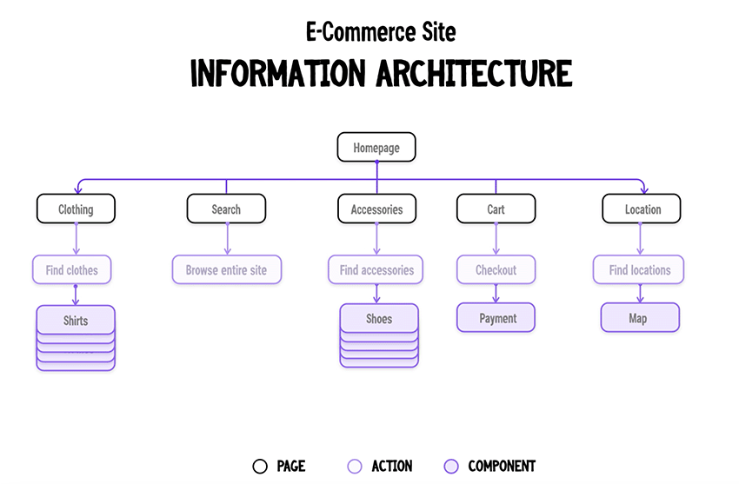

Slide 6
The role of IA in design:
a)
▪
IA and UX Design
Many people may have the question: “Isn’t IA the same as
UX design?”.
Technically, these terms relate to each other but they are far not the same. IA is a blueprint of the design structure which can be generated into wireframes and sitemaps of the project. UX designers use them as the basic materials so that they could plan navigation system.
Let’s get this straight: good IA is a foundation of efficient user experience, so the IA skill is essential for the designers
▪
▪

Slide 7
b) IA System Components
▪
If you want to build strong information architecture for
the product, you need to understand what it consists of.
Pioneers of the IA field, Lou Rosenfeld and Peter Moville
in their book “IA for the World Wide Web” have
distinguished four main components: organization systems, labeling systems, navigation systems and searching systems.
Organization systems
These are the groups or the categories in which the information is divided. Such system helps users to predict where they can find certain information easily.
There are three main organizational structures: Hierarchical, Sequential, and Matrix.
▪
1)
•
•

Slide 8
Hierarchical
• It is initially based on Gestalt psychological theory and its main goal is to present content on the carrier, be it a book page or poster, web page or mobile screen, in such a way that users can understand the level of importance for each element.
• It activates the ability of the brain to distinguish objects on the basis of their physical differences, such as size, colour, contrast, alignment etc.

Slide 9
Sequential
• This structure creates some kind of a path for the users.
They go step-by-step through content to accomplish the task they needed.
• This type is often used for the retail websites or apps, where people have to go from one task to another to make the purchase.

Slide 10
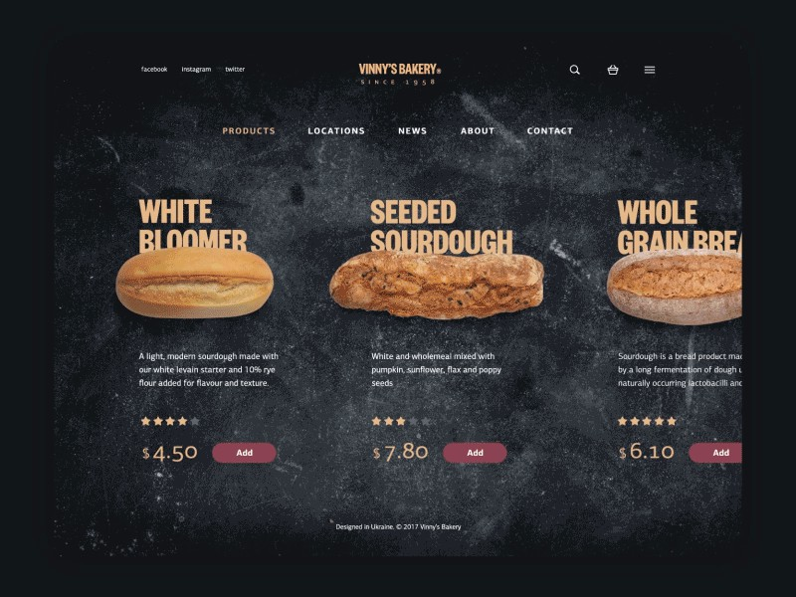

Slide 11
Matrix
• This type is a bit more complicated for the users since they choose the way of navigation on their own.
• Users are given choices of content organization. For example, they can navigate through content which is ordered according to date, or some may prefer navigation along the topic.

Slide 12
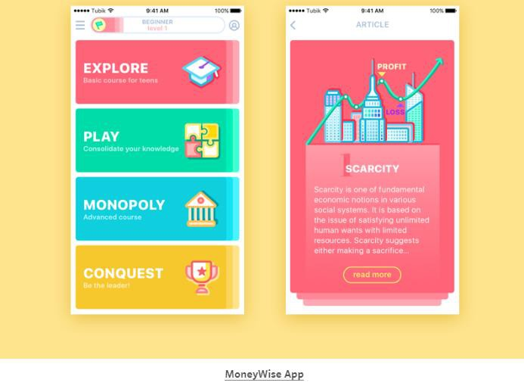

Slide 13
•
In addition, content can be grouped according to the
organization schemes. They are meant to categorize content the product. Here are some of the popular schemes:
Alphabetical schemes. Content is organized in alphabetical order. Also, they can serve as a navigation tool for the users.
Chronological schemes. This type organizes content by
date.
Topic schemes. Content is organized according to the specific subject.
Audience schemes. The type of content organization for
separate groups of users.
•
•
•
•

Slide 14
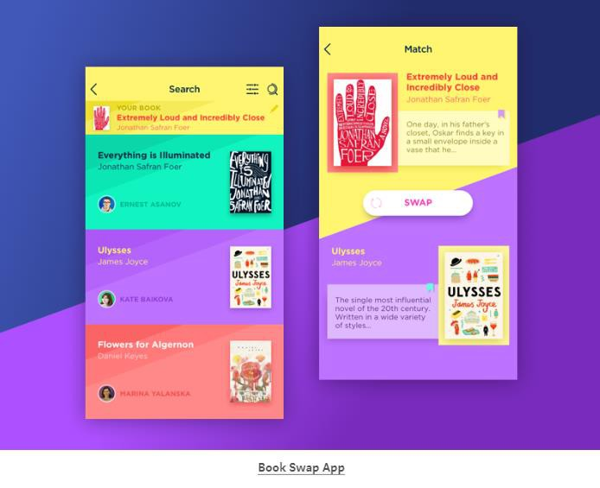

Slide 15
2) Labeling systems
•
•
This system involves the ways of data representation.
Design of the product requires simplicity, so a great amount of information can confuse users.
That’s why designers create the labels which represent
loads of data in few words.
For example, when the designers give contact information of the company on the website, it usually includes the phone number, email, and social media contacts.
However, designers can’t present all of this information
on one page. The button “Contact” in the header of the page is a label that triggers the associations in the users’ heads without placing the whole data on the page.
So, the labeling system aims at uniting the data effectively.
•
•
•

Slide 16
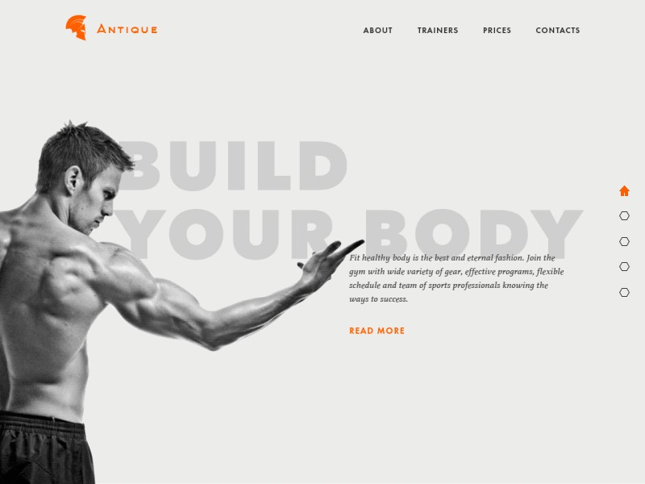

Slide 17
3) Navigation systems
• In one of our UX Glossary articles, we’ve defined
navigation as the set
users throughout the fulfil their goals and product.
of actions and techniques guiding
app or website, enabling them to successfully interact with the
• The navigation system, in terms of IA, involves the ways
how users move through content. It’s a complex system which employs many techniques and approaches, the reason why it’s wrong to describe it in a short paragraph.

Slide 18
4) Searching systems
• This system is used in information architecture to help users search for the data within the digital product like a website or an app.
• The searching system is effective only for the products with loads of information when the users risk getting lost there.
• In this case, the designers should consider a search engine, filters, and many other tools helping users find content and plan how the data will look after the search.

Slide 19
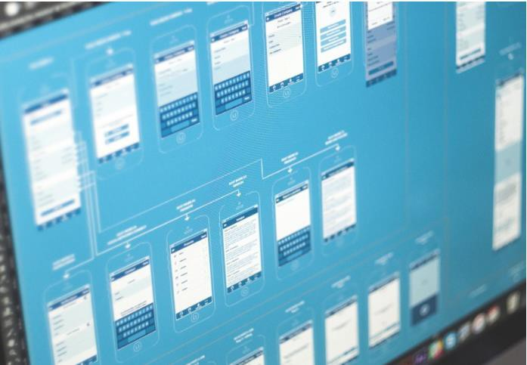

Slide 20
2. Interaction Design

Slide 21
What is Interaction Design?
▪ It is design of the interaction between users and products.
Most often when people talk about interaction design, the products tend to be software products like apps or websites.
▪ The goal of interaction design is to create products that enable the user to achieve their objective(s) in the best way possible.

Slide 22
The 5 dimensions of interaction design
▪ Gillian Crampton Smith,an Interaction Design academic, first introduced the concept of four dimensions of an interaction design language, to which Kevin Silver, senior interaction designer at IDEXX Laboratories, added the fifth.
1D: Words
▪ Words—especially those used in interactions, like button labels—should be meaningful and simple to understand. They should communicate information to users, but not too much information to overwhelm the user.

Slide 23
2D: Visual representations
▪ This concerns graphical elements like
images, typography and icons that users interact with. These usually supplement the words used to communicate information to users.
3D: Physical objects or space
▪ Through what physical objects do users interact with the product? A laptop, with a mouse or touchpad? Or a smartphone, with the user’s fingers?

Slide 24
4D:Time
▪ While this dimension sounds a little abstract, it mostly refers to media that changes with time (animation, videos, sounds).
5D:Behaviour
▪ This includes the mechanism of a product: how do users perform actions on the website? How do users operate the product?
▪ In other words, it’s how the previous dimensions
define the interactions of a product. It also includes the reactions—for instance emotional responses or feedback—of users and the product.

Slide 25
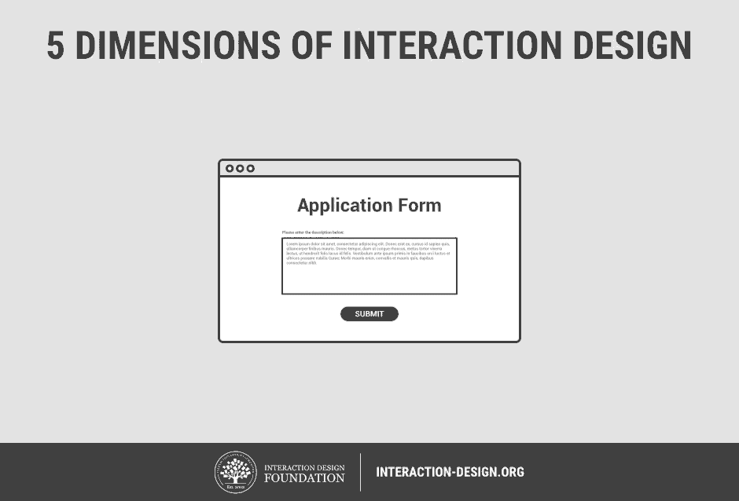

Slide 26
3. Wireframes, Mockups,
Prototypes: Introduction

Slide 27
What is Wireframe?
▪
A wireframe is neither more nor less than a draft of the
product. When painting a picture, an artist firstly draws a sketch. It works the same way with mobile and web design.
Wireframe introduces a general scheme of the app or site and shows the layout of its components. It is usually the first step in the design process.
Wireframes may differ depending on the level of detalization. However, all of them reflect a basic view of app or site with a proper placement of buttons, tabs, icons, and other elements.
▪
▪

Slide 28
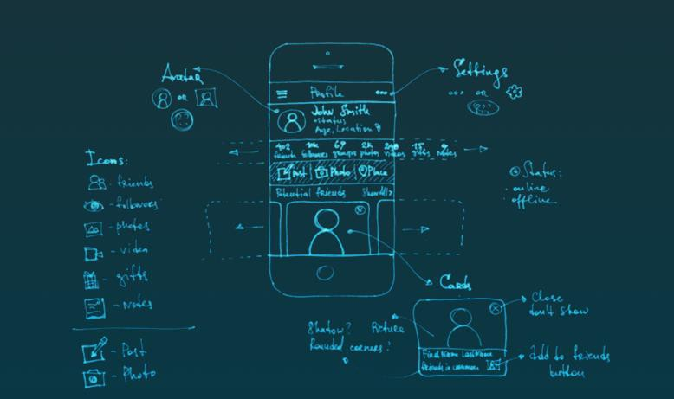

Slide 29
How to make a wireframe?
▪ The wireframe should be created with reference to
specific features of the product. Also, you should
the end-user.
▪ Before you begin wireframing, try to answer the
following questions:
– Which UI elements are the most important for
consider
the user?
– Which elements are of a secondary consideration?
– How are they going to be arranged?
– What content will appear on the page?

Slide 30
Why is wireframe needed?
▪ Wireframes help to organize data and clearly shows a content to be displayed on a certain app screen or website page.
▪ You might omit wireframing if you work on a very simple
and non-lasting project.
▪ If this is not the case, approach to the task with a great care. As a result, you will gain the following benefits:
– Clarity: since you will know for sure which elements are
going to be located on the defined screens or pages.
– Adjusting: since you can easily control the placement of elements, move or delete them if needed.
– Connection: since your client will be deeply involved in
the planning process.
– Protection: since you minimize the possibility to re-do the whole work from scratch.

Slide 31
What is Mockup?
▪ Mockups reflect the design choices for color schemes, layouts, typography, iconography, the visuals of navigation, and the overall atmosphere of the product.
▪ Mockups serve both for the team and the client. The first uses it as a detailed instruction for the development, the second - as a clear example of the finished product.

Slide 32
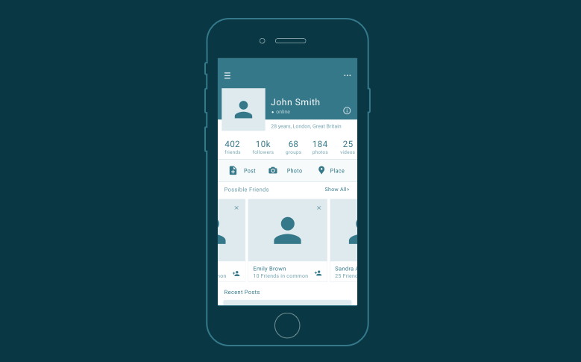

Slide 33
How to make a Mockup?
▪ When you were working with a wireframe, it was your right to decide which level of detailization is needed depending on the target users.
▪ With Mockups, the situation is rather different. It is
unlikely that you will create it for your own use.
▪ Before you start working, determine the answers to the questions below:
– Which colour-grade is to be applied?
– How will the navigation be organized?
– Which input fields, search signs, menu buttons, and other parts are currently missing?
– What is the common style or your app / site?

Slide 34
Why is Mockup needed?
▪ You will get the following advantages:
– Specification : since your team receives a detailed description of the product.
– Understanding: since you see the product just the way the
users are going to see it.
– Perfection: since you can work through each minute detail.
– Confidence: since you know that you are headed in the right direction.

Slide 35
3. Prototyping Introduction

Slide 36
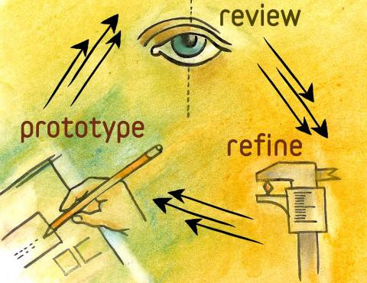
What is a Prototype, Exactly?
▪ “A simulation or sample version of a final product, which
is used for testing prior to launch.”
▪ The goal of a prototype is to test products (and product ideas) before sinking lots of time and money into the final product.

Slide 37
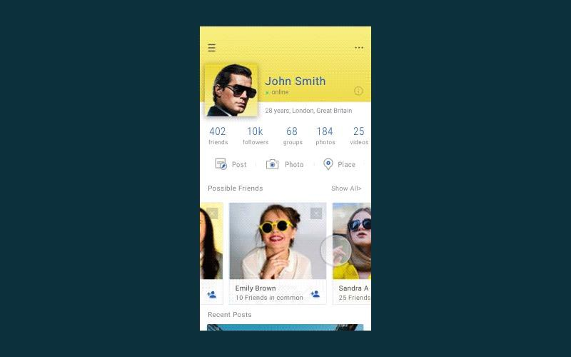

Slide 38
Prototypes have 4 main qualities:
•
Representation — The actual form of the prototype, i.e.,
paper and mobile, or HTML and desktop.
Precision — The fidelity of the prototype, meaning its
level of detail, polish, and realism.
Interactivity — The functionality open to the user, e.g., fully functional, partially functional, or view-only
Evolution — The lifecycle of the prototype. Some are built quickly, tested, thrown away, and then replaced with an improved version (this is known as “rapid prototyping”). Others may be built and improved upon, ultimately evolving into the final product.
•
•
•

Slide 39
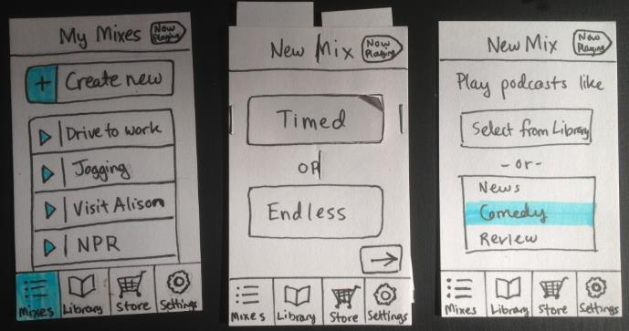
The Most Useful Prototyping Methodology
1)
Paper Prototyping

Slide 40
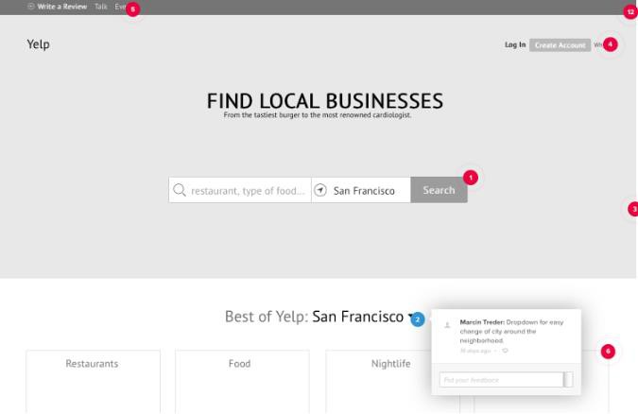
2)
Digital Prototyping

Slide 41
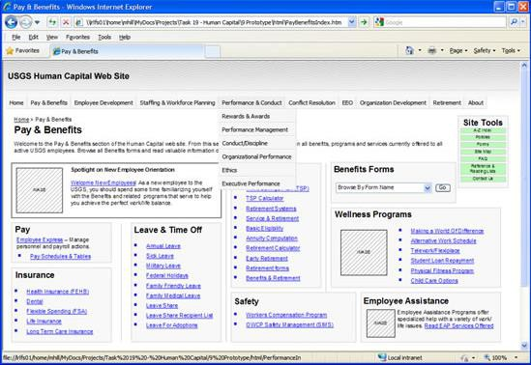
3) HTML Prototyping

Slide 42
The Prototyping Process
▪ Below are the three most effective processes, each suited to different needs.
1)
2)
3)
Lo-fi Digital => Hi-fi Digital => Code
Paper => Lo-fi Digital => Code
HTML Prototyping => Code

Slide 43
4. Design Paradigm

Slide 44
4.1
4.2
4.3
Engineering Paradigm
Human Information Processing (HIP) Paradigm
Design-Thinking Paradigm

Slide 45
4. Design Thinking

Slide 46
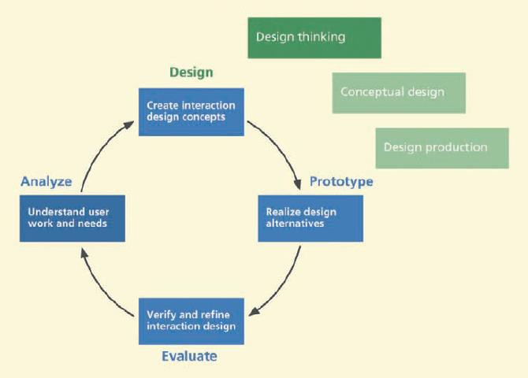

Slide 47
5. Design Perspectives

Slide 48
5.1
5.2
5.3
Ecological Perspective
Interaction Perspective
Emotional Perspective

Slide 49
6. User Persona

Slide 50
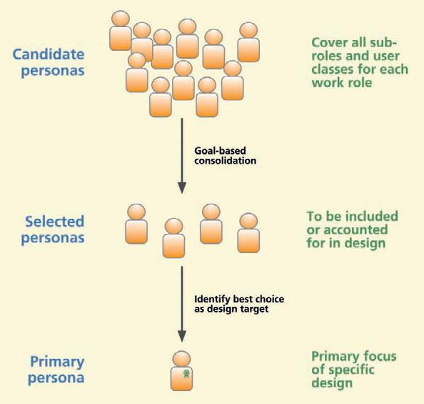

Slide 51
7. Ideation

Slide 52
▪
Ideation is an active, fast-moving collaborative group
process for forming ideas for design.
It is an activity that goes with design thinking; you might say that ideation is a tool of design thinking; “ideation is applied design thinking”.
Ideation is where you start your conceptual design.
Ideation is where you brainstorm to come up with ideas to
solve design problems.
Ideation is inseparable from sketching and evaluation aimed at exploration of design ideas.
▪
▪
▪
▪

Slide 53
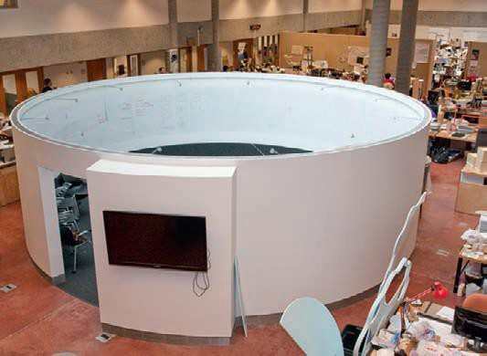
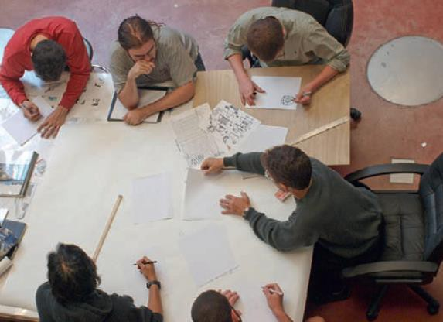
▪ Essential Concepts
– Iterate to explore
– Idea creation vs. Critiquing
▪ Doing Ideation
– Set up work spaces
– Assemble a team
– Use ideation bin ideas to get started

Slide 54
7. Sketching

Slide 55
▪ Sketching is the rapid creation of freehand drawings
expressing preliminary design ideas, focusing
rather than details.
7.1 Essential Concepts
• Sketching is essential to ideation and design
• What sketching is and is not
• Sketches are not the same as prototypes
on
concepts
• Sketching is embodied cognition to aid invention
7.2 Doing Sketching
• Stock up on sketching and mockup supplies
• Use the language of sketching

Slide 56
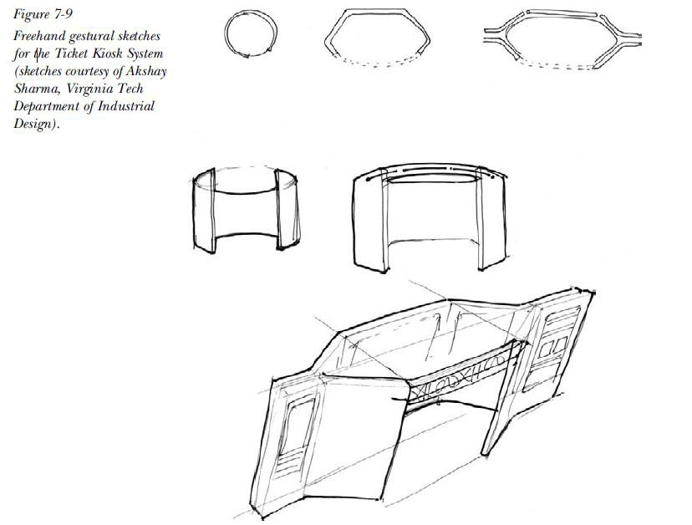

Slide 57
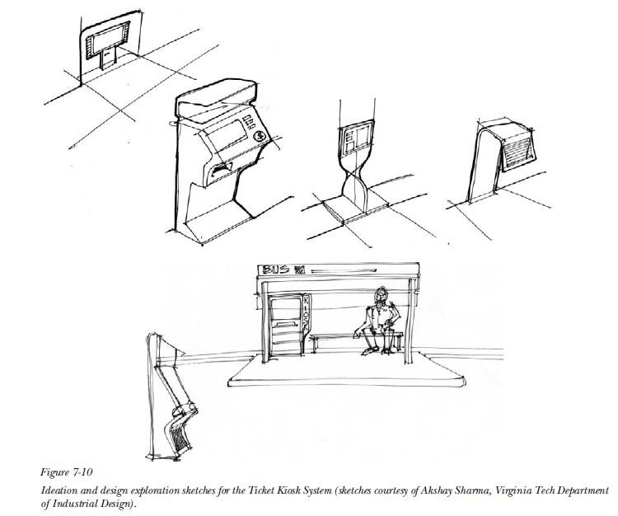

Slide 58
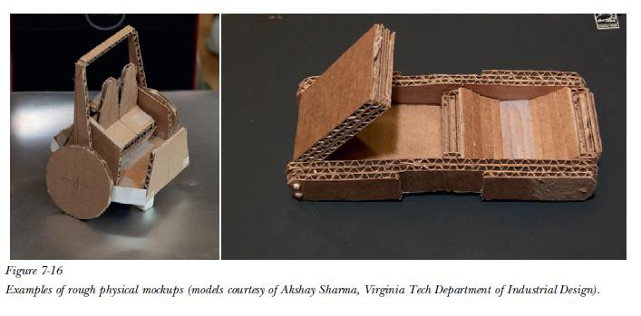
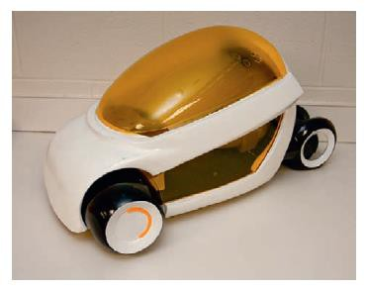
7.3 Physical Mockups as Embodied Sketches

Slide 59
8. Mental Models and Conceptual
Design

Slide 60
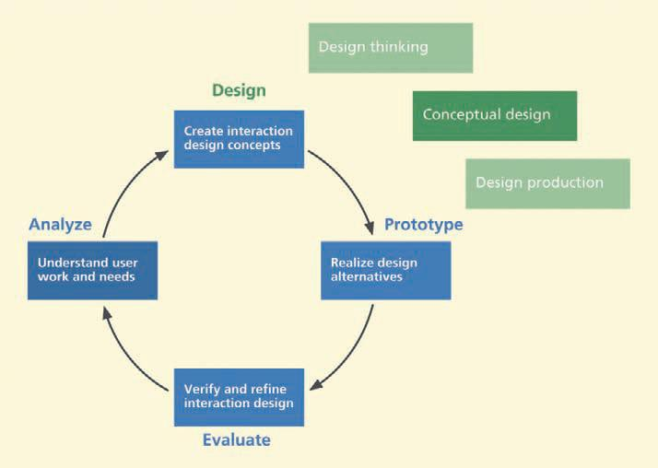

Slide 61
“A mental model is an explanation of someone’s thought
process about how something works in the real world.”
8.1 Designer’s Mental Model
Sometimes called a conceptual model (Johnson
Henderson, 2002, p. 26),the designer’s mental model is
the designer’s conceptualization
• what the system is?
• how it is organized?
• what it does?
• how it works?
of
the
envisioned
system

Slide 62
8.2 User’s Mental Model
• A user’s mental model is a conceptualization or internal explanation each user has built about how a particular system works.
• As Norman says (1990), it is a natural human response to an unfamiliar situation to begin building an explanatory model a piece at a time.

Slide 63
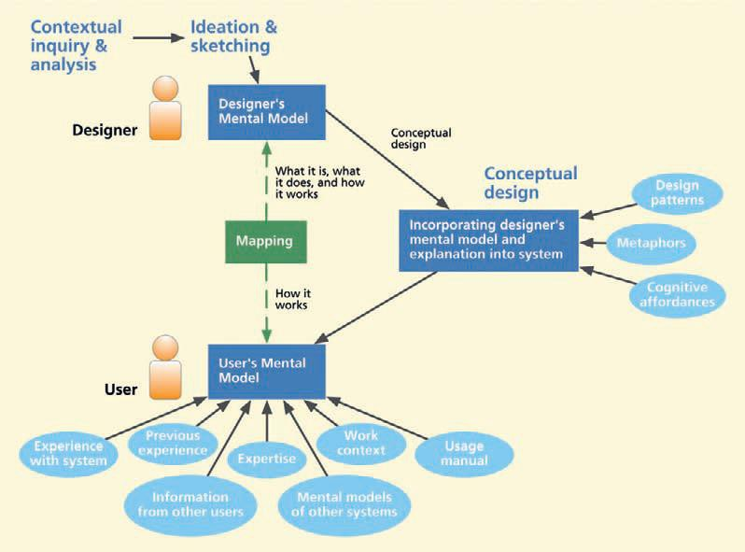
Mapping the designer’s mental model to the user’s mental model.

Slide 64
8.3 What Is a Conceptual Design?
“
A conceptual design is the part of an interaction design
containing a theme, notion, or idea with the purpose
of
communicating a design vision about a system
product.”
or
8.4
8.5
8.6
Start with a Conceptual Design
Leverage Metaphors in Conceptual Design
Conceptual Design from the Design Perspectives
• Conceptual design in the ecological perspective
• Conceptual design in the interaction perspective
• Conceptual design in the emotional perspective

